Slide 1

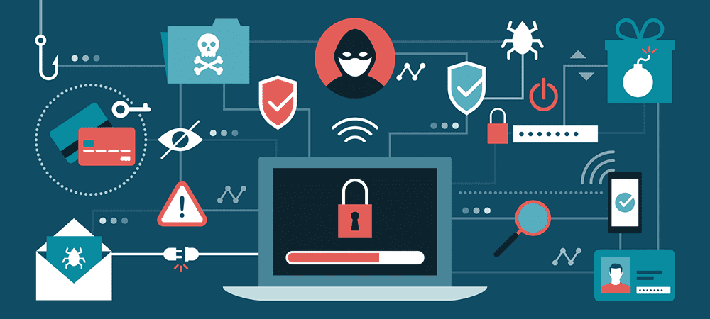
Computer Threats: What are they, What can they do, and How to Reduce Vulnerabilities
Justyce Countryman
Jefferson Community College
What is a Computer Threat?
Ten Possible Modern Computer Threats
Solutions for Computer Prosperity
Computer threats make computer hardware and software vulnerable to cybercriminals. This may result in endangering one or more computing devices, network connections, and forms of personal information.
Malware: Any form of software that intends to take advantage of “any programmable device, service, or network.” Internet criminals utilize malware for stealing computer data, files, and information.
Adware: Software that displays inessential advertisements. Adware may exploit browser activity or take control of a computer.
Ransomware: Encrypts all files until the user makes a specified payment. Sometimes installs by itself.
Spyware: Software that could take personal computer information and monitor communication from a device without consent.
Trojans: Tricks users into installing harmful software that appears to be safe. This may result in trojans watching computer activity, crashing computer systems, and sending more threats.
Viruses: The portion of malware that executes malicious activity. Once a file with a virus is open, the computer receives the virus almost instantly. Email attachments are primary sources.
Spam: Inessential messages through the internet with the objective of “advertising, phishing, or releasing malware.” Spam is viewable because of bulk emails, instant messages, comments, and posts from social media.
Worms: Spreads to multiple computers without user interaction and takes advantage of security vulnerabilities within software.
Bots: Software that performs internet tasks automatically. Some bots aid the computer while others search for websites that contain potential malicious software.
Install official or certified anti-virus software
Enable Windows Defender
Update all software as soon as possible
Back up data consistently
Refrain from installing applications that are not from reliable creators.
Avoid opening websites or downloadable attachments that are clearly skeptical
Utilize a firewall
If there are signs of a rootkit attack, remove everything from the operating system
Reasons why Computer Threats Occur
No anti-virus protection
Not updating regularly
Opening dubious emails or files
Downloading hazardous software
References
https://www.monster.com/career-advice/article/computer-threats-protect
https://www.metacompliance.com/blog/what-is-malware-and-how-to-prevent-against-it/
https://www.mcafee.com/en-us/antivirus/malware.html
https://softwarelab.org/what-is-adware/
https://www.reveantivirus.com/en/computer-security-threats/what-is-spam
https://www.imperva.com/learn/application-security/what-are-bots/
https://us.norton.com/internetsecurity-malware-what-is-a-rootkit-and-how-to-stop-them.html
https://www.cnet.com/hhttps://www.metacompliance.com/blog/what-is-malware-and-how-to-prevent-against-it/
ow-to/the-best-antivirus-protection-of-2020-for-windows-10/
Rootkits: Malware that is difficult for users to discover since it can bypass security protection software. Rootkits give cybercriminals almost full control of a computer. They may find passwords, credit card numbers, banking statements, and other personal information. Rootkits can also keep track of which keys a user types. They could stick around for a long time and continuously produce harm. Dangerous files inside of emails or risky applications are where this threat originates commonly.

Slide 2
Works Cited
https://www.monster.com/career-advice/article/computer-threats-protect
https://www.metacompliance.com/blog/what-is-malware-and-how-to-prevent-against-it/
https://www.mcafee.com/en-us/antivirus/malware.html
https://softwarelab.org/what-is-adware/
https://www.reveantivirus.com/en/computer-security-threats/what-is-spam
https://www.imperva.com/learn/application-security/what-are-bots/
https://us.norton.com/internetsecurity-malware-what-is-a-rootkit-and-how-to-stop-them.html
https://www.metacompliance.com/blog/what-is-malware-and-how-to-prevent-against-it/
https://www.cnet.com/how-to/the-best-antivirus-protection-of-2020-for-windows-10/

